Slide 1
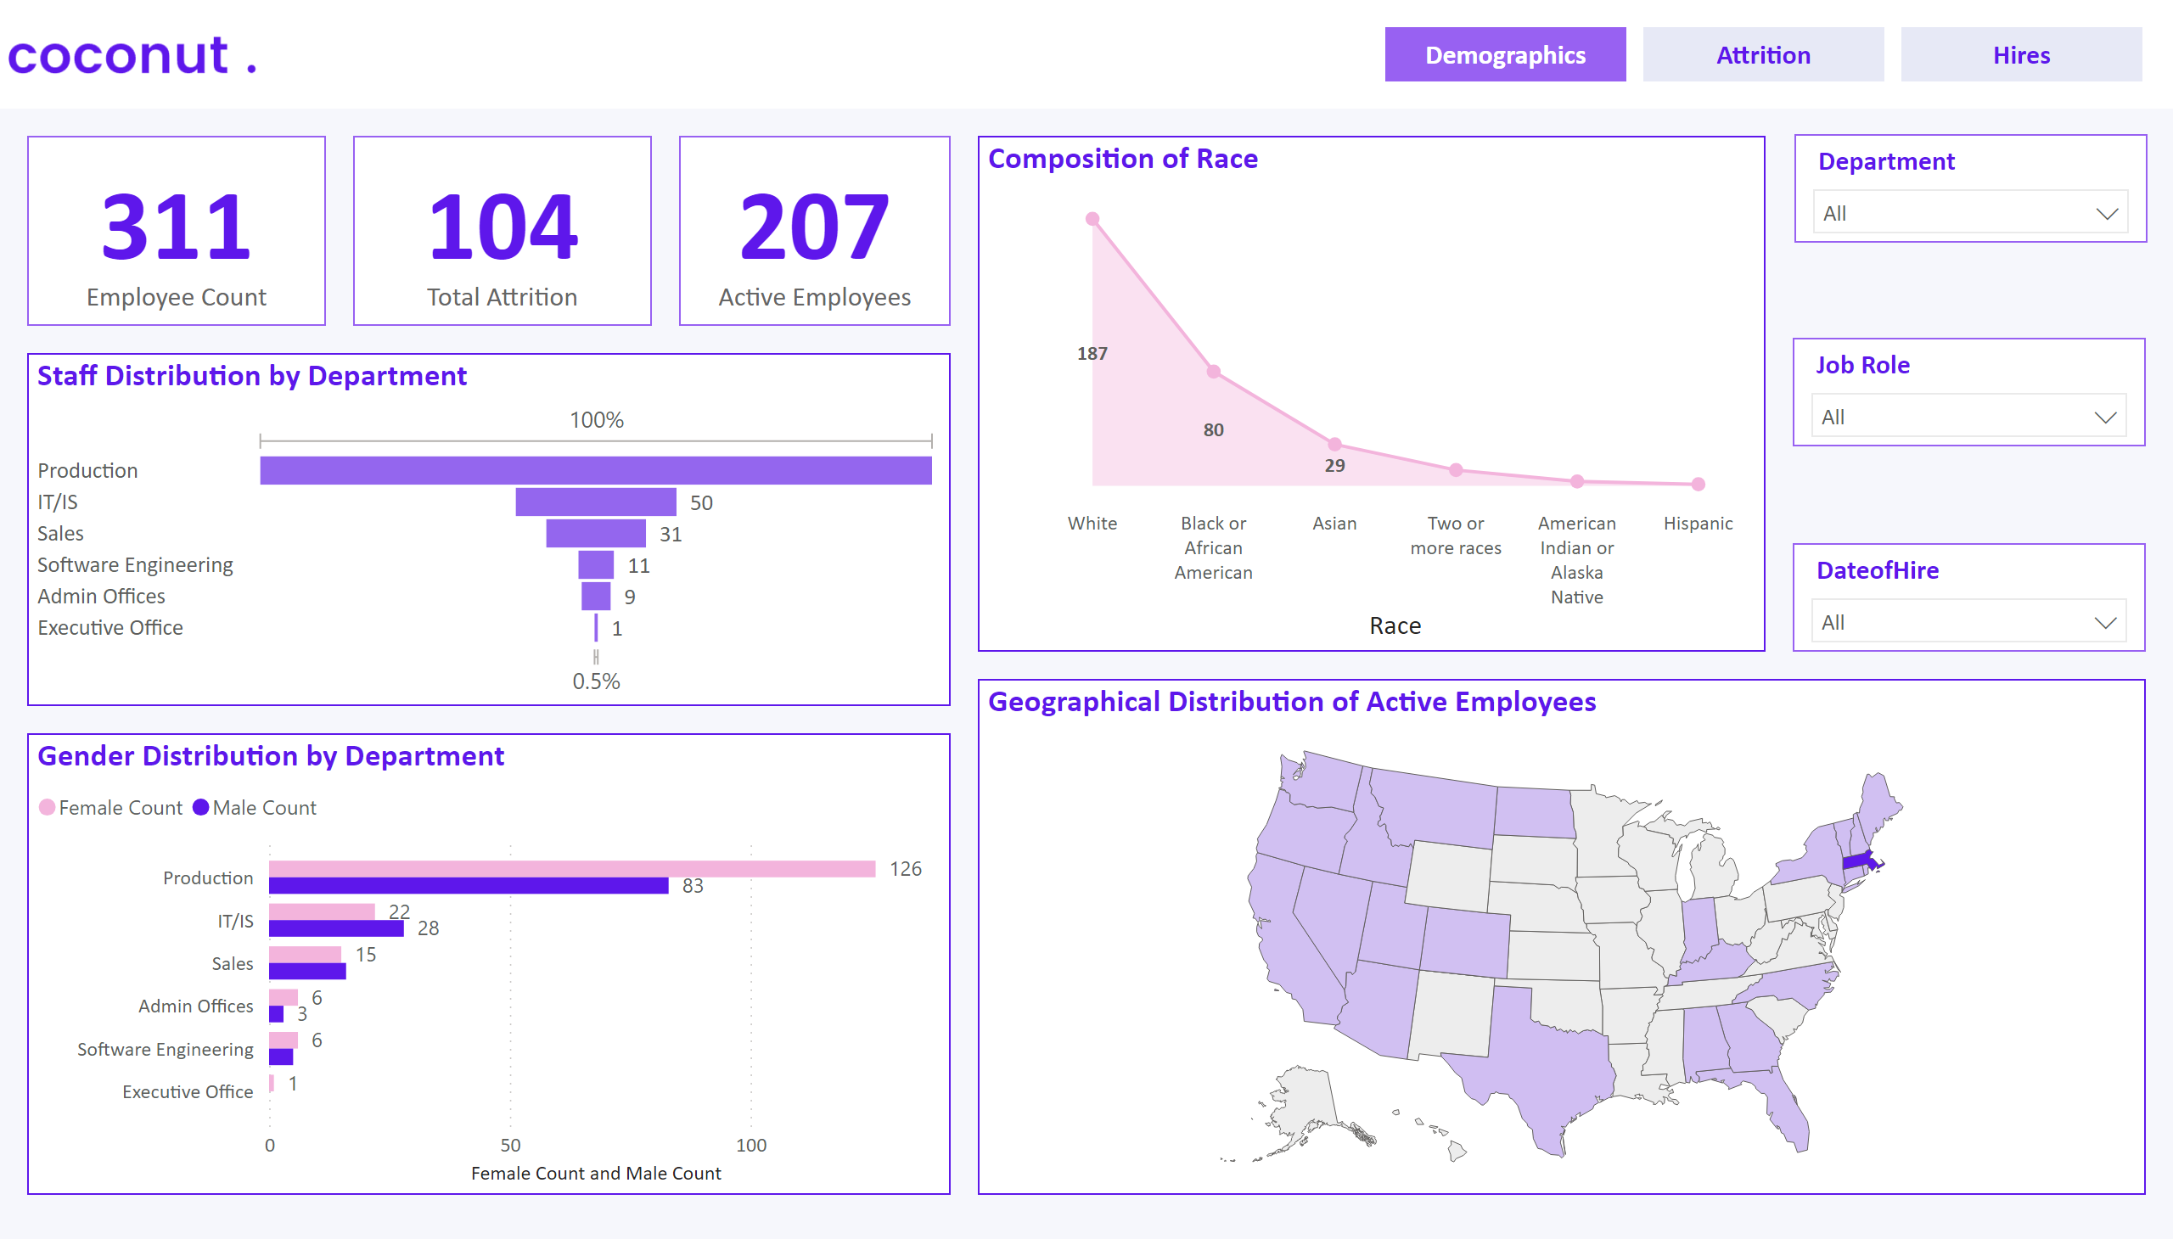
Demographics
Notes:
slicer
No alt text provided
slicer
No alt text provided
slicer
No alt text provided
card
No alt text provided
image
No alt text provided
card
No alt text provided
card
No alt text provided
Gender Distribution by Department
No alt text provided
Staff Distribution by Department
No alt text provided
Composition of Race
No alt text provided
Geographical Distribution of Active Employees
No alt text provided
shape
No alt text provided
pageNavigator
No alt text provided

Slide 2
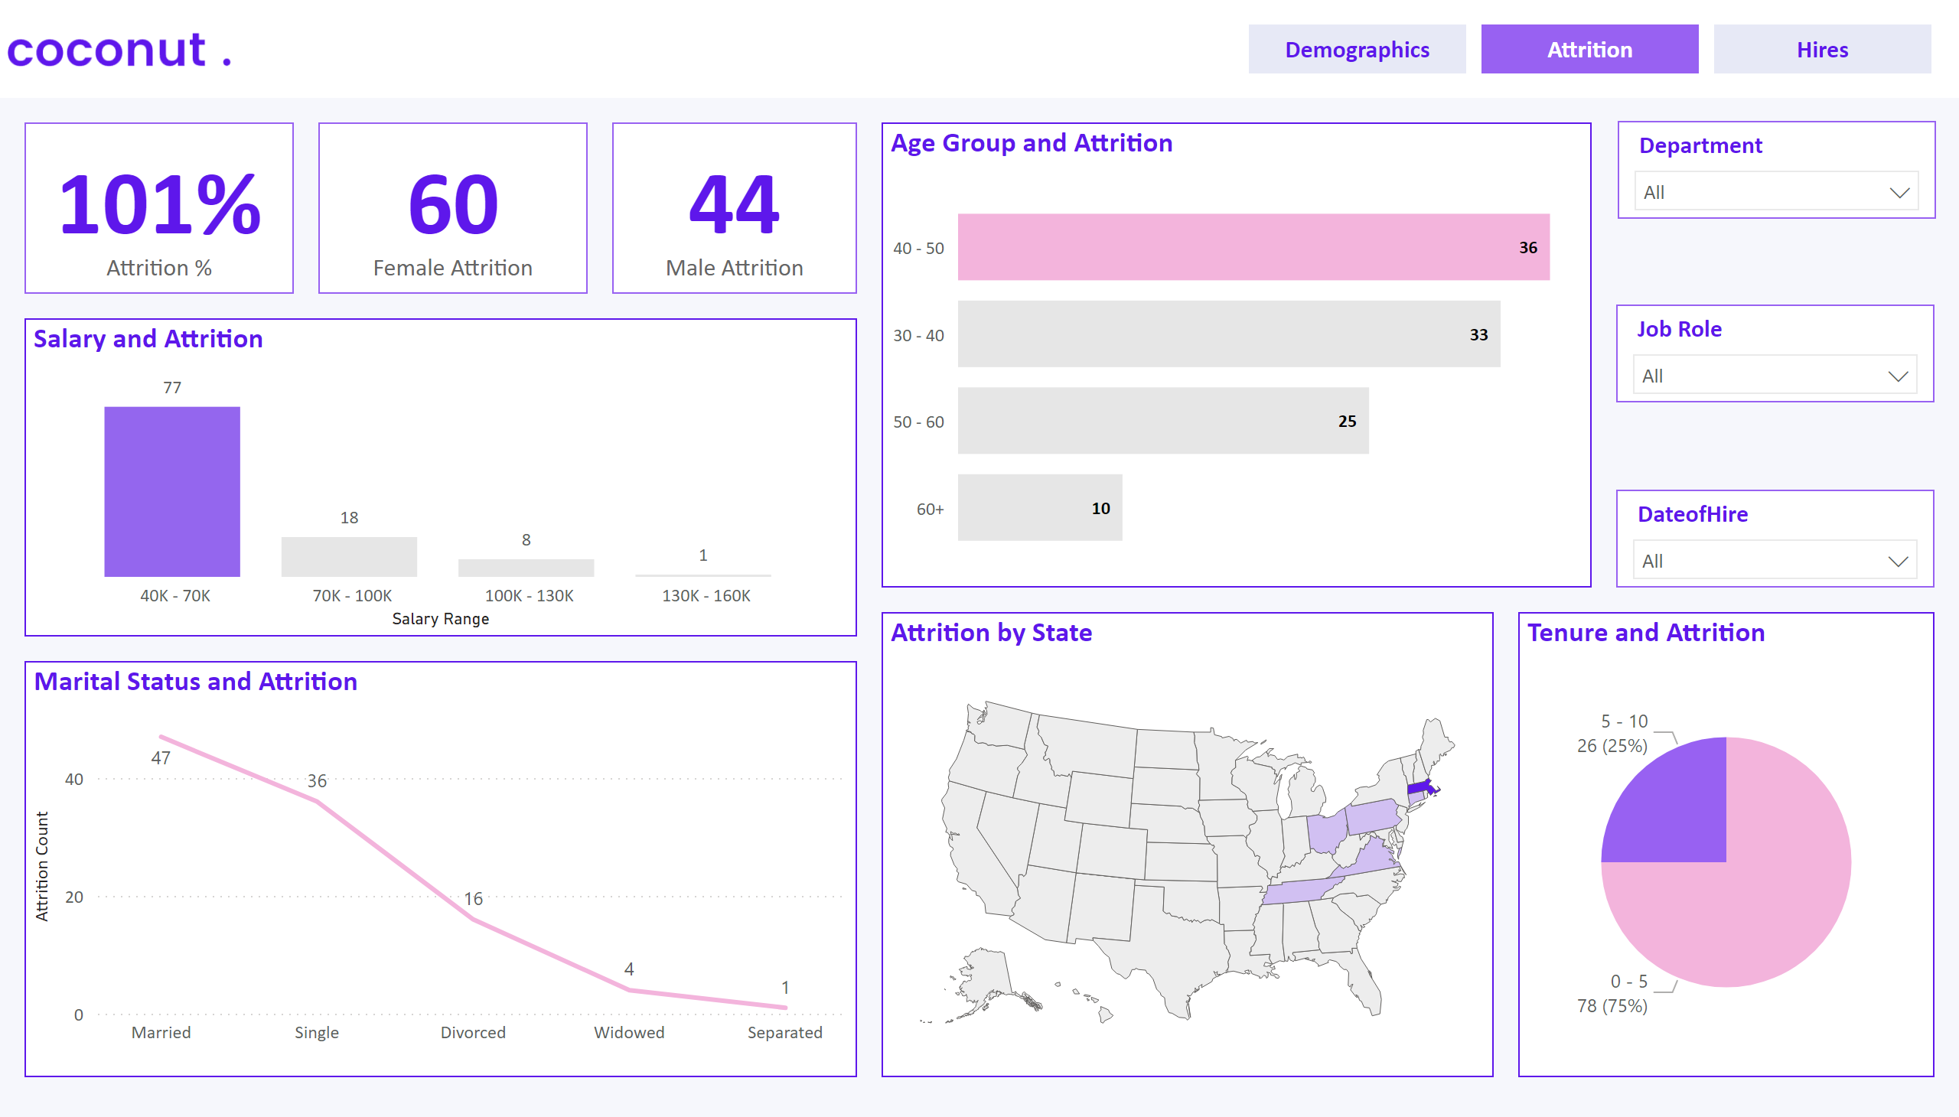
Attrition
Notes:
slicer
No alt text provided
slicer
No alt text provided
slicer
No alt text provided
card
No alt text provided
image
No alt text provided
card
No alt text provided
card
No alt text provided
Marital Status and Attrition
No alt text provided
Salary and Attrition
No alt text provided
Age Group and Attrition
No alt text provided
Attrition by State
No alt text provided
shape
No alt text provided
pageNavigator
No alt text provided
Tenure and Attrition
No alt text provided

Slide 3
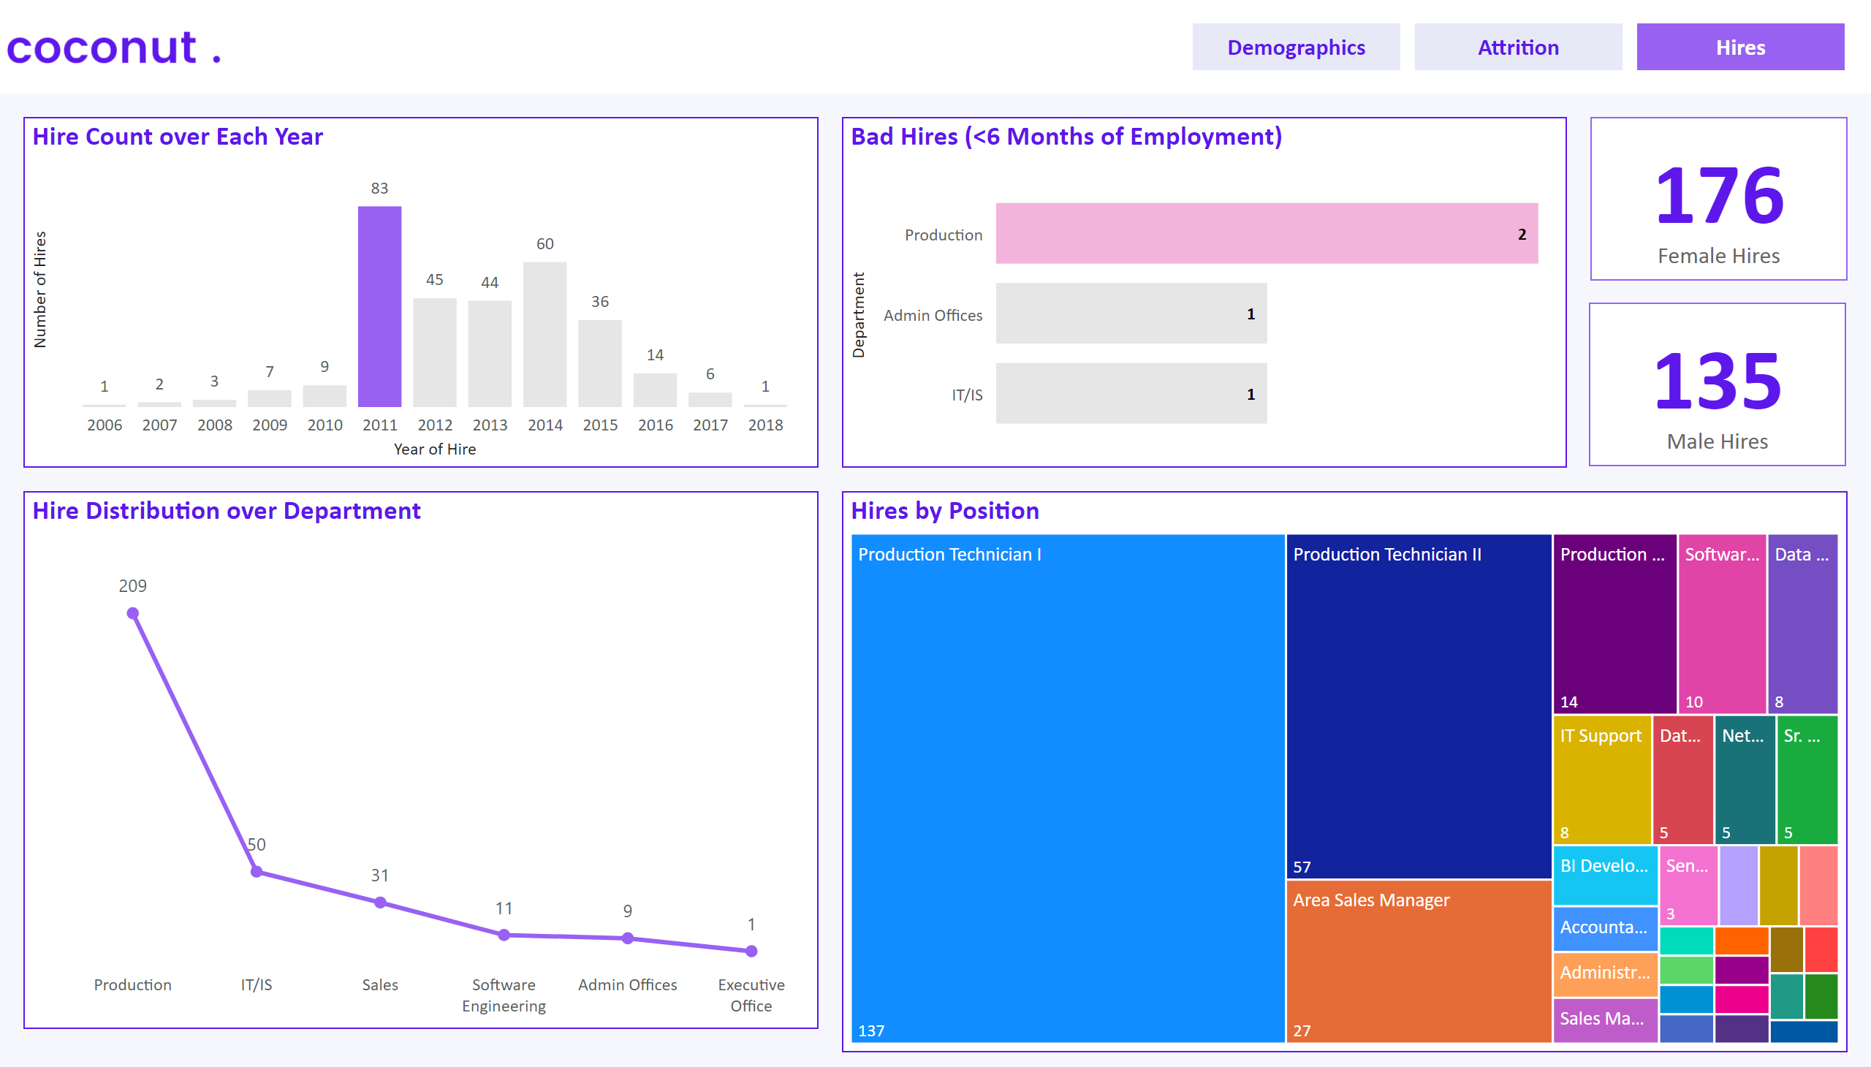
Hires
Notes:
image
No alt text provided
card
No alt text provided
card
No alt text provided
Hires by Position
No alt text provided
Hire Count over Each Year
No alt text provided
Bad Hires (<6 Months of Employment)
No alt text provided
Hire Distribution over Department
No alt text provided
shape
No alt text provided
pageNavigator
No alt text provided

